Slide 1
BTP Presentation: Response Time Analysis
Advisor: Prof. Vikas Bajpai
Shivam Sharma • 15UCS130
Vivek Kumar • 15UCS162

Slide 2
Overview
Expected delivery
By 7th Semester
Work Done
Website Requirements.
Website Collection
Data Collection: Graphs and Response Time
Prediction Result
Biggest risk
Inaccurate Analysis

Slide 3
About:
Website response time is one of the most important performance parameter of website. It can be used to assess website performance to forecast the status of website. Large amounts of data are applied by a distributed monitoring system that monitoring a university website response time. Support vector machine with information granulation is studied to predict the response time. It can predict accurately the range of ultimate response time, the relative accuracy of the forecast average response time can reach 96.2%.

Slide 4
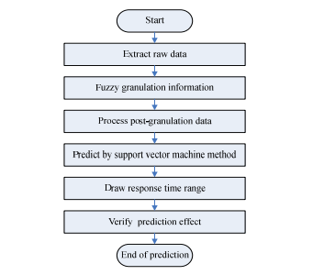
Source: IEEE Research Paper

Slide 5
Progress - Website Requirements
Types of Website:
In-order to get accurate response time data of website, we needed self-hosted websites so speed of internet does not provide in-accurate throughput.
Other Software Requirements
Currently, we are using following softwares for web-hosting (localhost)
WAMP | XAMPP
BadBoy

Slide 6
Progress - What is XAMPP?
XAMPP:
XAMPP is a free and open-source cross-platform web server solution stack package developed by Apache Friends, consisting mainly of the Apache HTTP Server, MariaDB database, and interpreters for scripts written in the PHP and Perl programming languages.

Slide 7
Progress - What is Badboy?
BadBoy:
Badboy is a powerful tool designed to aid in testing and development of complex dynamic applications. Badboy makes web testing and development easier with dozens of features including a simple yet comprehensive capture/replay interface, powerful load testing support, detailed reports, graphs and much more!

Slide 8
Progress - Website Collection
We have collected a total of 100 self-hosting websites out of 400-500 websites.

Slide 9
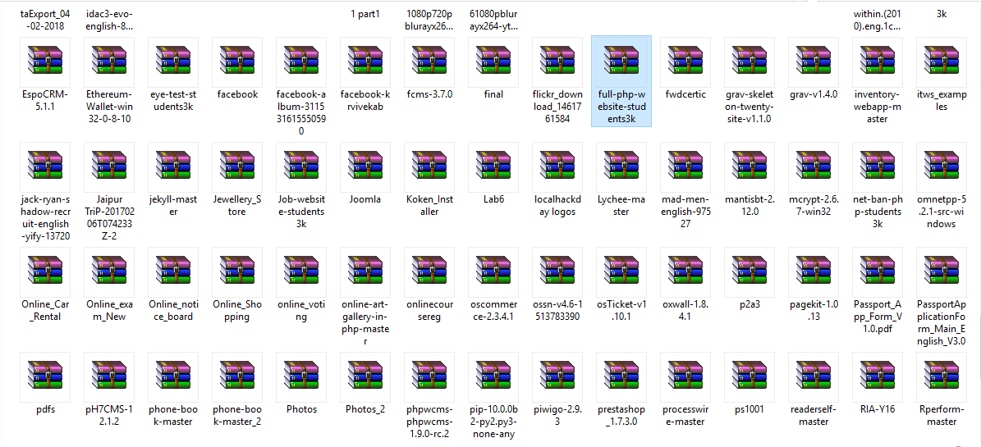

Slide 10
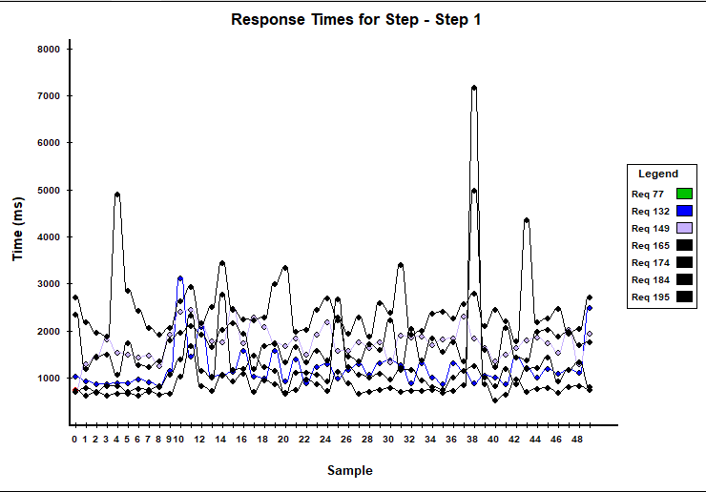
Progress - Data Collection - Graphs

Slide 11
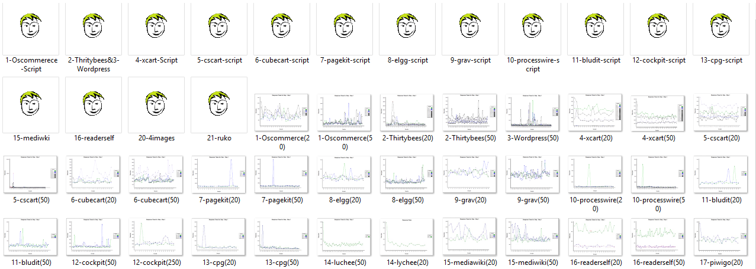
Progress - Data Collection - Graphs

Slide 12
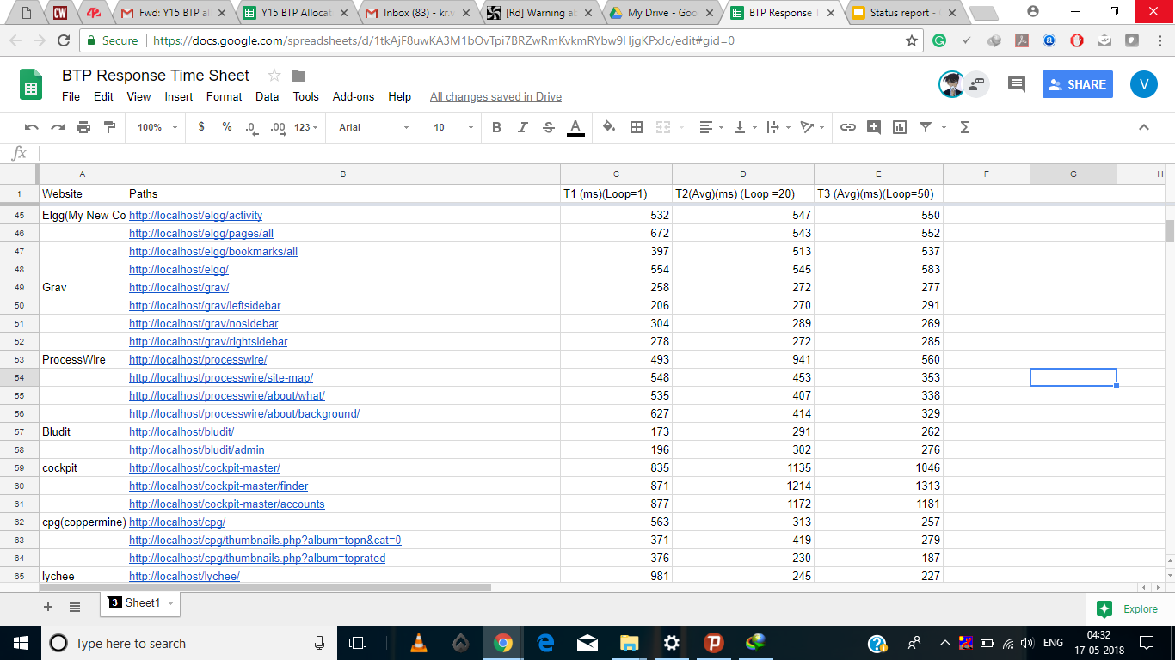
Progress - Data Collection - Response Time

Slide 13
Schedule

Slide 14
Started collecting data and graphs
Project Announced
Cleaning of Data
Feb 2018
March 2018
April 2018
May 2018
August 2018
Search for all the required software and learning to use them
Website Collection Completed

Slide 15
Prediction Work
Sept. 2018
Nov. 2018
Dec. 2018
August 2018
Learning about SVR
Final Presentation

Slide 16
Prediction Using SVR
Why use SVR?
Which kernel to use?
How to train and test?

Slide 17
Why use SVR?
SVR is used when we have data points less than 1000 and here we had 184 urls to train on which was 80% of the data.
We used 20% of the remaining 47 urls for testing.

Slide 18
Preprocessing step -
As we had empty spaces in the datafile so we did preprocessing on the NaN values present below the names of the website.
For this we used dropna() and set their values to 0.

Slide 19
Kernel to use?
We first tried the default kernel which is rbf, then we did polynomial and linear.
By doing accuracy analysis and doing some research we understood that to get a good curved function we needed rbf(Radial Basis Function) kernel.

Slide 20
Training and Testing
We used 80% of the data for training. The remaining 20% for testing.
We used the first two columns as input and trained the model on the third column.
Then we tested it for the rest 20% with and the input of first two columns and predicted the third column.

Slide 21
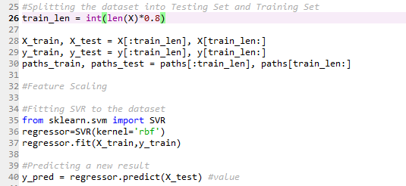
Snapshots
Training and Testing.

Slide 22
Plotting the Results
For plotting we used matplotlib.
We made a scatter plot.
With X-axis as the number of urls and Y-axis as response time in ms.
Red color for actual response time.
Blue color for the predicted response time.

Slide 23
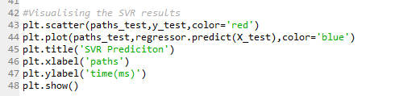
Snapshots
Plotting.

Slide 24
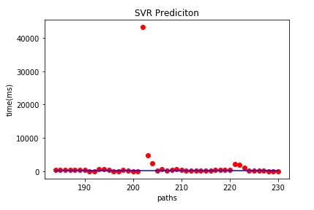
Resulting Plot
Result.

Slide 25
Results
So we used 231 urls for training and 47 urls for testing.
There are some outliers in the plot.
Overall the plot shows nice fit as was expected while our conversations with our mentor.

Slide 26
What can go wrong
As the data was less the model may be prey to underfitting.
We hosted the websites on our computer with other programs working and the performance of the server may be different at times.

Slide 27
Comparison
The other research paper we studied included the network bandwidth also in the response time calculations which we did not. Hence we had an upper hand on the predictions.
They had more data than us. Which is a con.

Slide 28
Research Paper Reference:
Prediction of website response time based on support vector machine
By: Xiaoming Zhang ; Cuixia Feng ; Guang Wang

Slide 29
Thank You! :)

